Slide 1
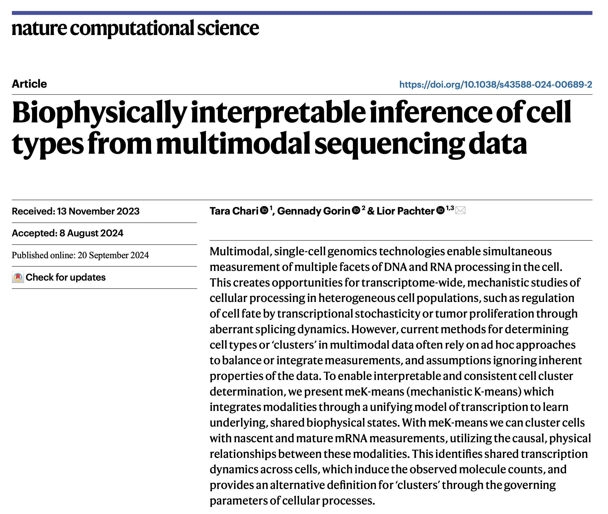
Journal club
12-17-2024
Ty Bottorff
Notes:
mechanistic K-means (meK-means) as a method to cluster cells from multimodal single-cell data under a self-consistent, biophysical model

Slide 2
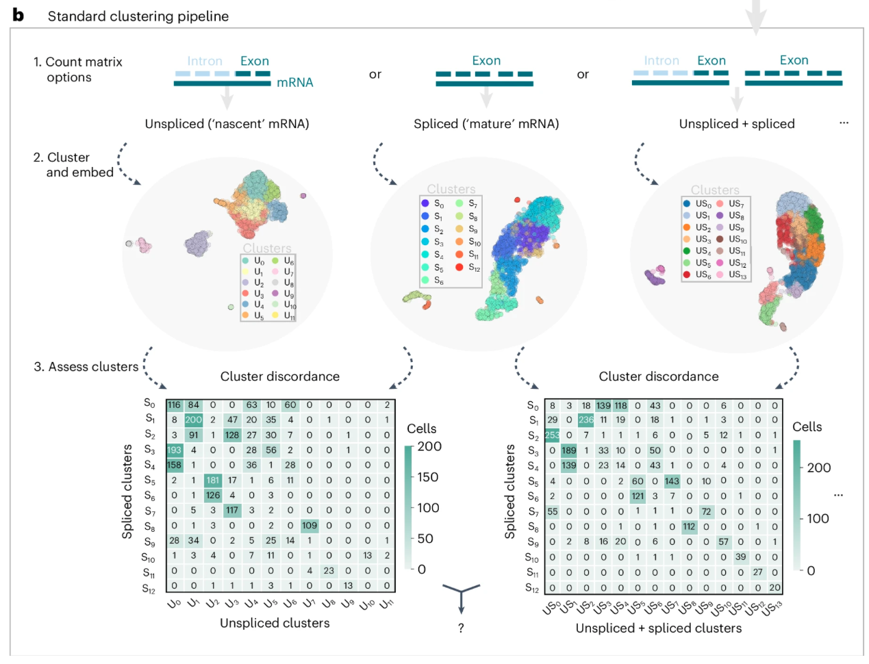
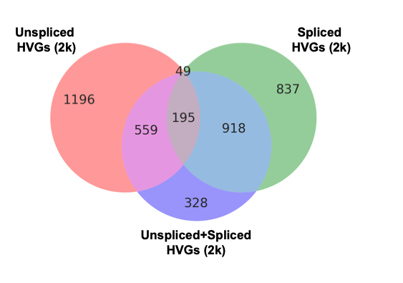
Modality choice impacts clustering, variable genes
Notes:
the common practice of using spliced expression may not be ideal, particularly if variability exists in another modality.
U and S are summed by default in the 10× Genomics Cell Ranger v.7.0.0 pipeline
Deep learning approaches^{32,33} do often use discrete distributions to represent data, but model modalities as independent observational distributions despite their innate causal, transcriptional relationships. It then remains unclear how to interpret the balance of modalities in such latent spaces
Existing multimodal approaches largely ignore unspliced RNA counts

Slide 3
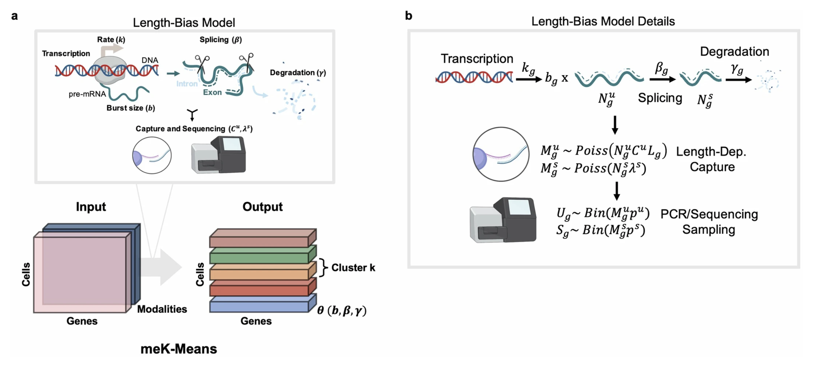
Length-bias Chemical Master Equation (CME) model
Notes:
CME describes probability of molecule counts over time, incorporating rates of transitions between molecule states (unspliced, spliced), useful for low-count sparse data like scRNAseq, extensively used in fluorescence transcriptomics
Model includes technical sampling during sequencing process (bias introduced), length-dependent capture
meK-means fits scRNAseq data to length-bias CME model of transcription, gene-specific parameters of transcription and technical parameters (like sequencing capture rates)

Slide 4
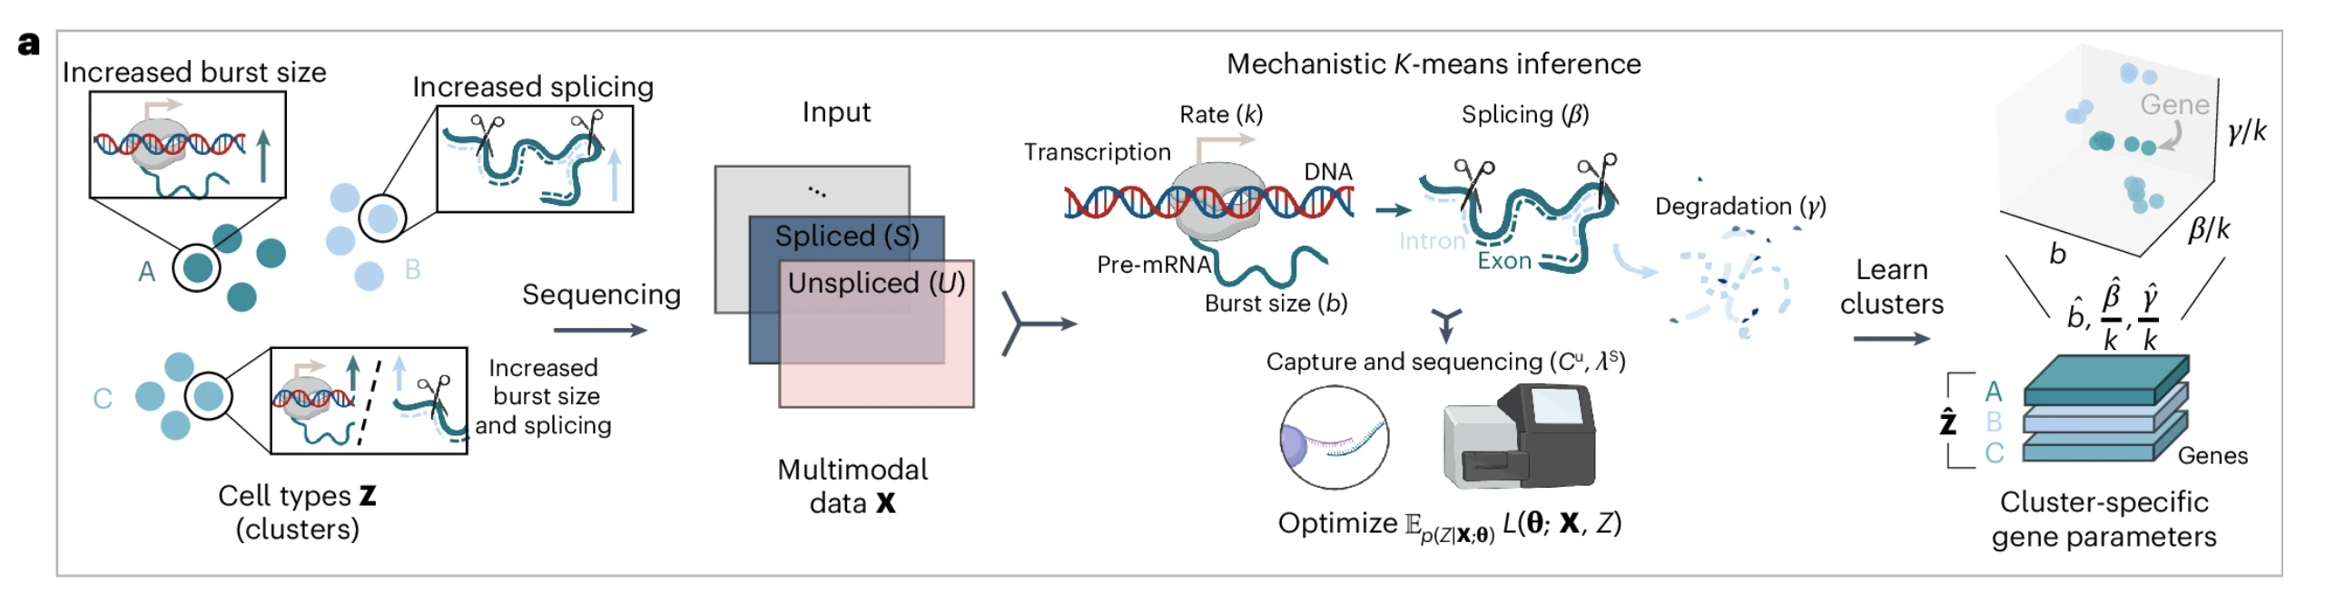
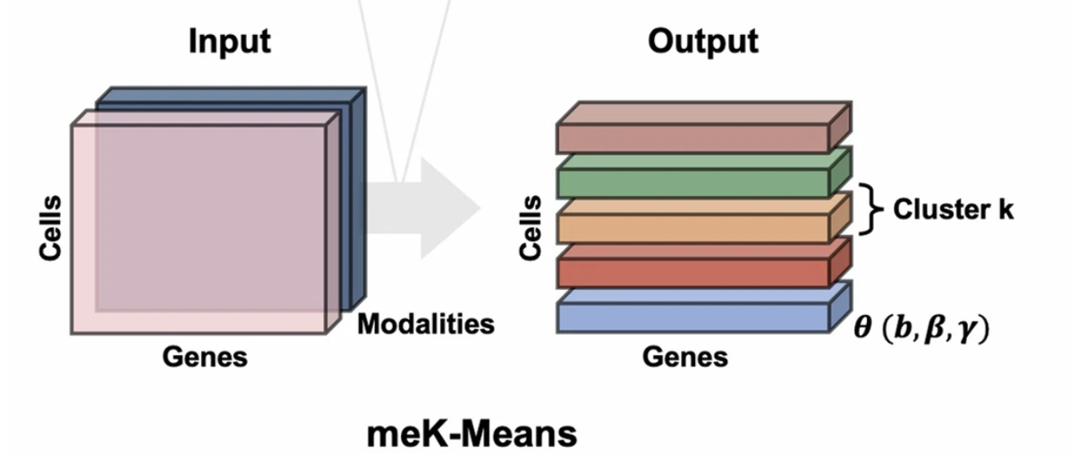
meK-means takes in (un)spliced RNA counts and clusters cells based on transcriptional dynamics
transcription rate k, mRNA burst size b, splicing rate β, and degradation of mRNA γ
Notes:
Output: cluster x gene x parameter matrix, each gene’s parameters inferred for each cell cluster
meK-means models joint distribution of U and S using biophysical transcription model, defines mixture model over joint distribution, learning clusters (Z) based on shared transcriptional dynamics
meK-means iteratively assigns cells to clusters and infers parameters that induce joint distribution that recaptulates observed counts
Technical sampling parameters set before inferring biophysical parameters

Slide 5
meK-means DEGs (DE-θ genes)
DE-θ genes: genes exhibiting DE at log2 FC > 2 in at least 1 parameter (burst size b, splicing rate β/k, mRNA degradation γ/k, collectively referred to as θ)
parameter-level FC may not be discernable FC at level of mean spliced expression (standard DEG), i.e. DE-θ genes may not necessarily be DE-μ_{s} genes (DEGs based on mean spliced counts μ_{s})

Slide 6
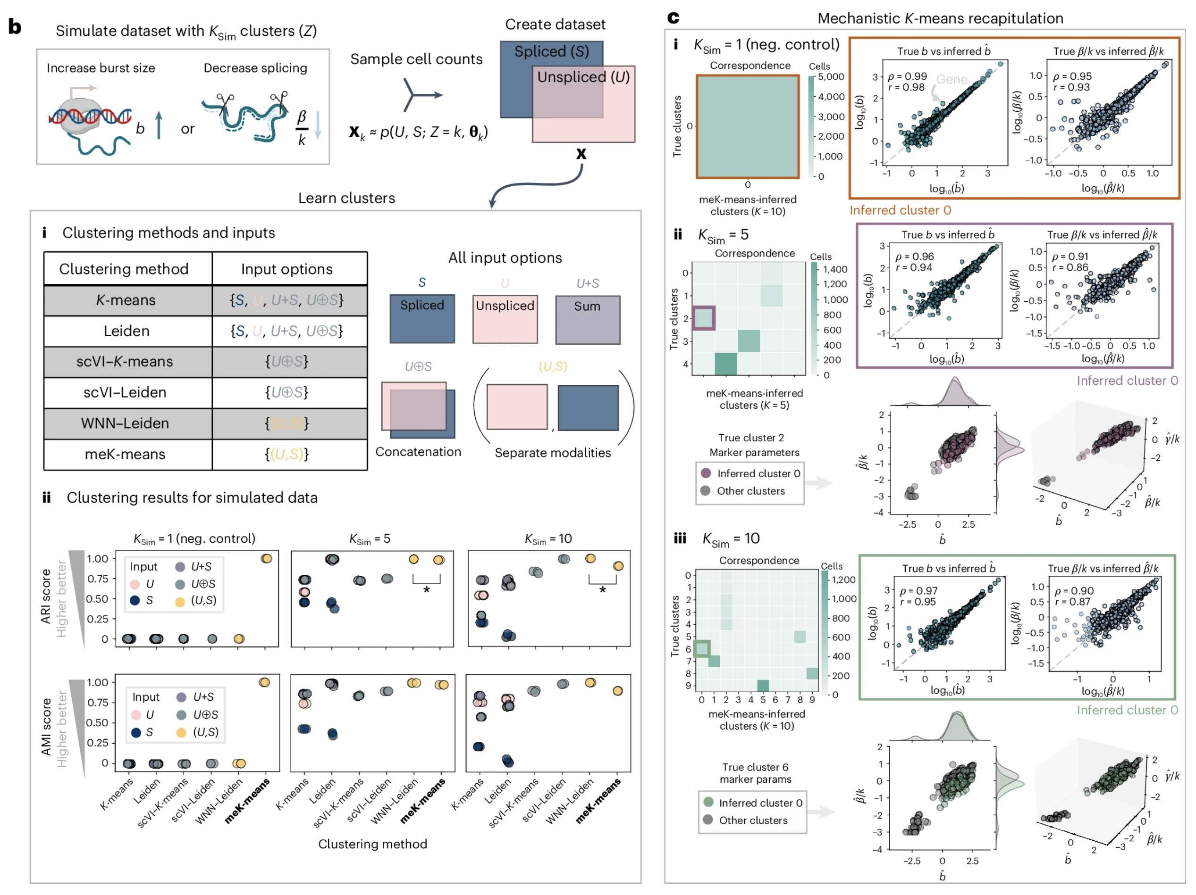
meK-means’ performance on simulated datasets
Notes:
meK-means effectively infers transcription parameters, converges to 1 cluster for negative control (where there’s no ground-truth cluster structure) unlike other methods
meK-means shows consistency in identifying clusters across simulations (consistently high ARI/AMI)
WNN-Leiden outperforms meK-means for larger cluster sims
Other methods perform poorly on datasets with high noise/dropout
Multiple input options tested (U+S is sum)
meK-means performs well under noisy conditions
meK-means able to recovery biophysical parameters with high correlation to true (simulated) parameters

Slide 7
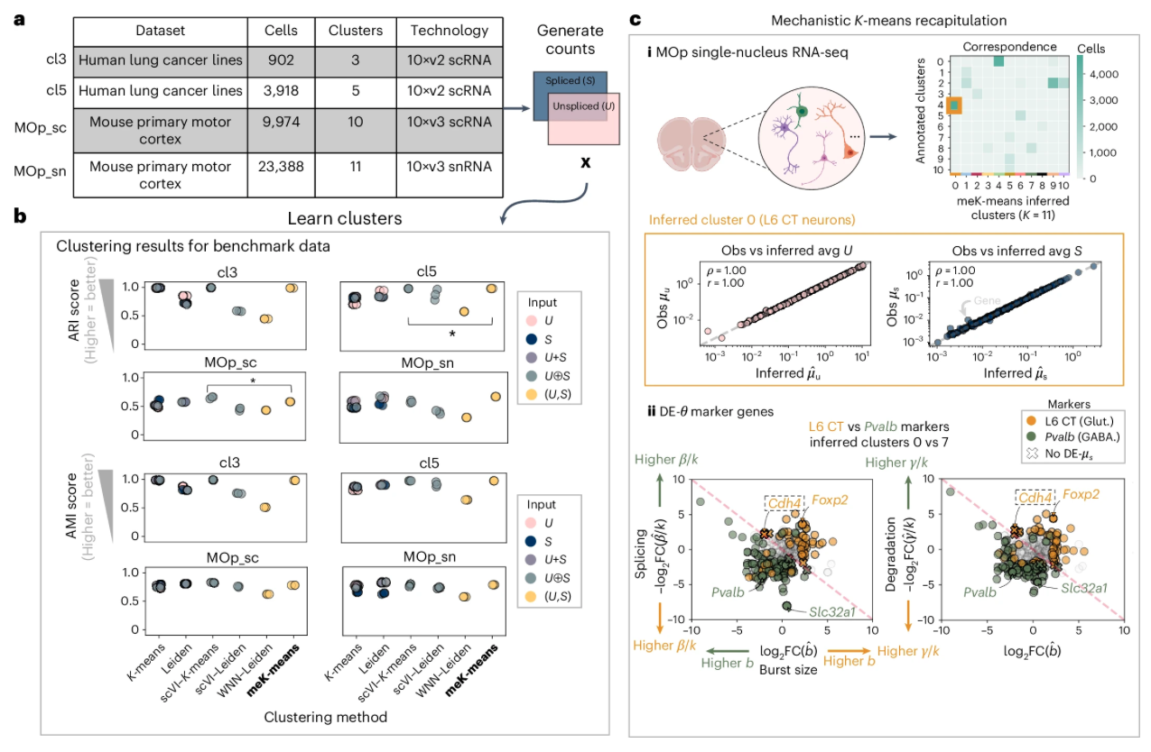
meK-means’ performance on biological datasets
Notes:
Benchmark using ground truth clusters or clusters from manual curation

Slide 8
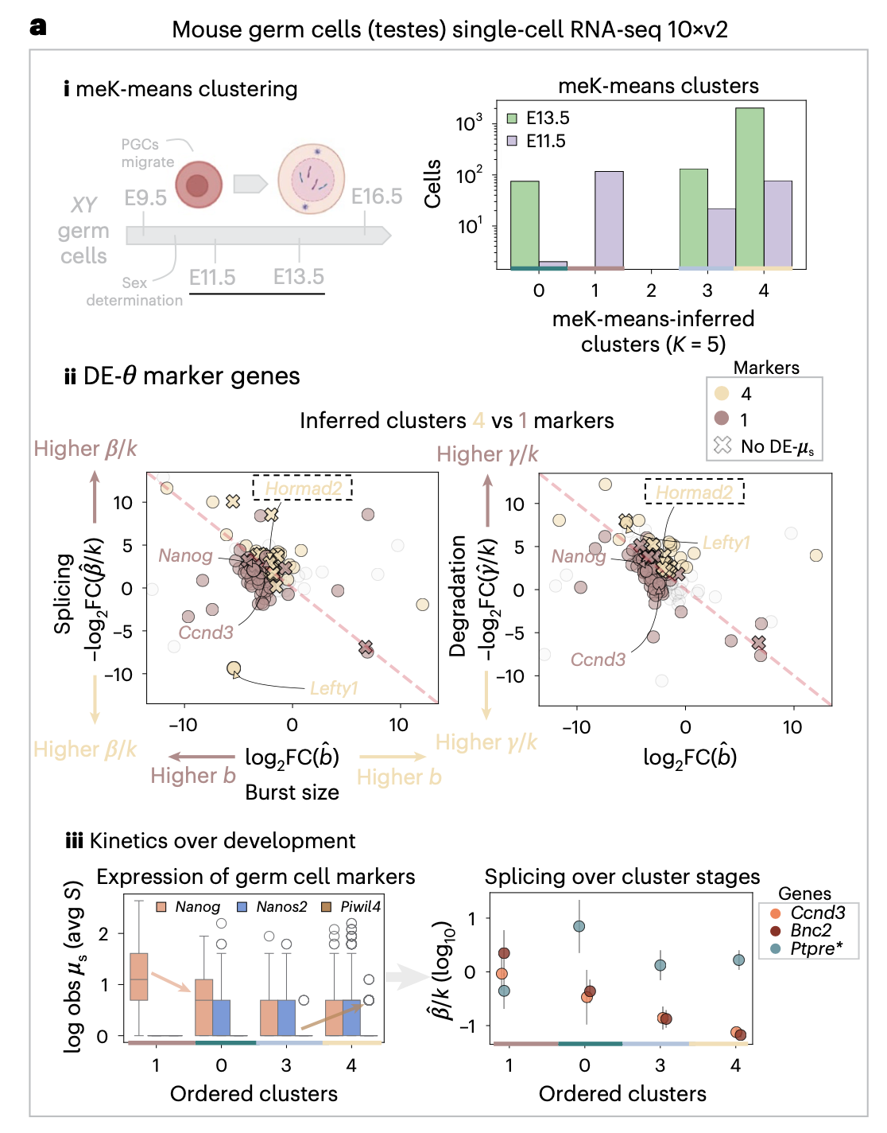
meK-means-based biological discoveries
Notes:
Spermatogenesis genes (Bnc2, Ccnd3) show decreased splicing, consistent with intron retention during spermatogenesis
Early stage markers (Nanog) in E11.5 cluster
Late stage markers (Lefty1, Hormad2) in E13.5 cluster with changes in transcriptional dynamics

Slide 9
meK-means vs. K-means
meK-means
Works well on sparse scRNAseq data (CME model)
Works on multimodal U,S input
Combines hard and soft assignments
Assigns each cell to only 1 cluster (hard)
But, still assesses how likely it was for that data point to end up in that cluster (~like Gaussian mixture models where data are assigned to clusters based on probability not definitively)
K-means
Groups data into hard clusters (only belong to 1 cluster)
Minimizes distance between data and cluster centroids
Works best when clusters are spherical in high dimensional space

Slide 10
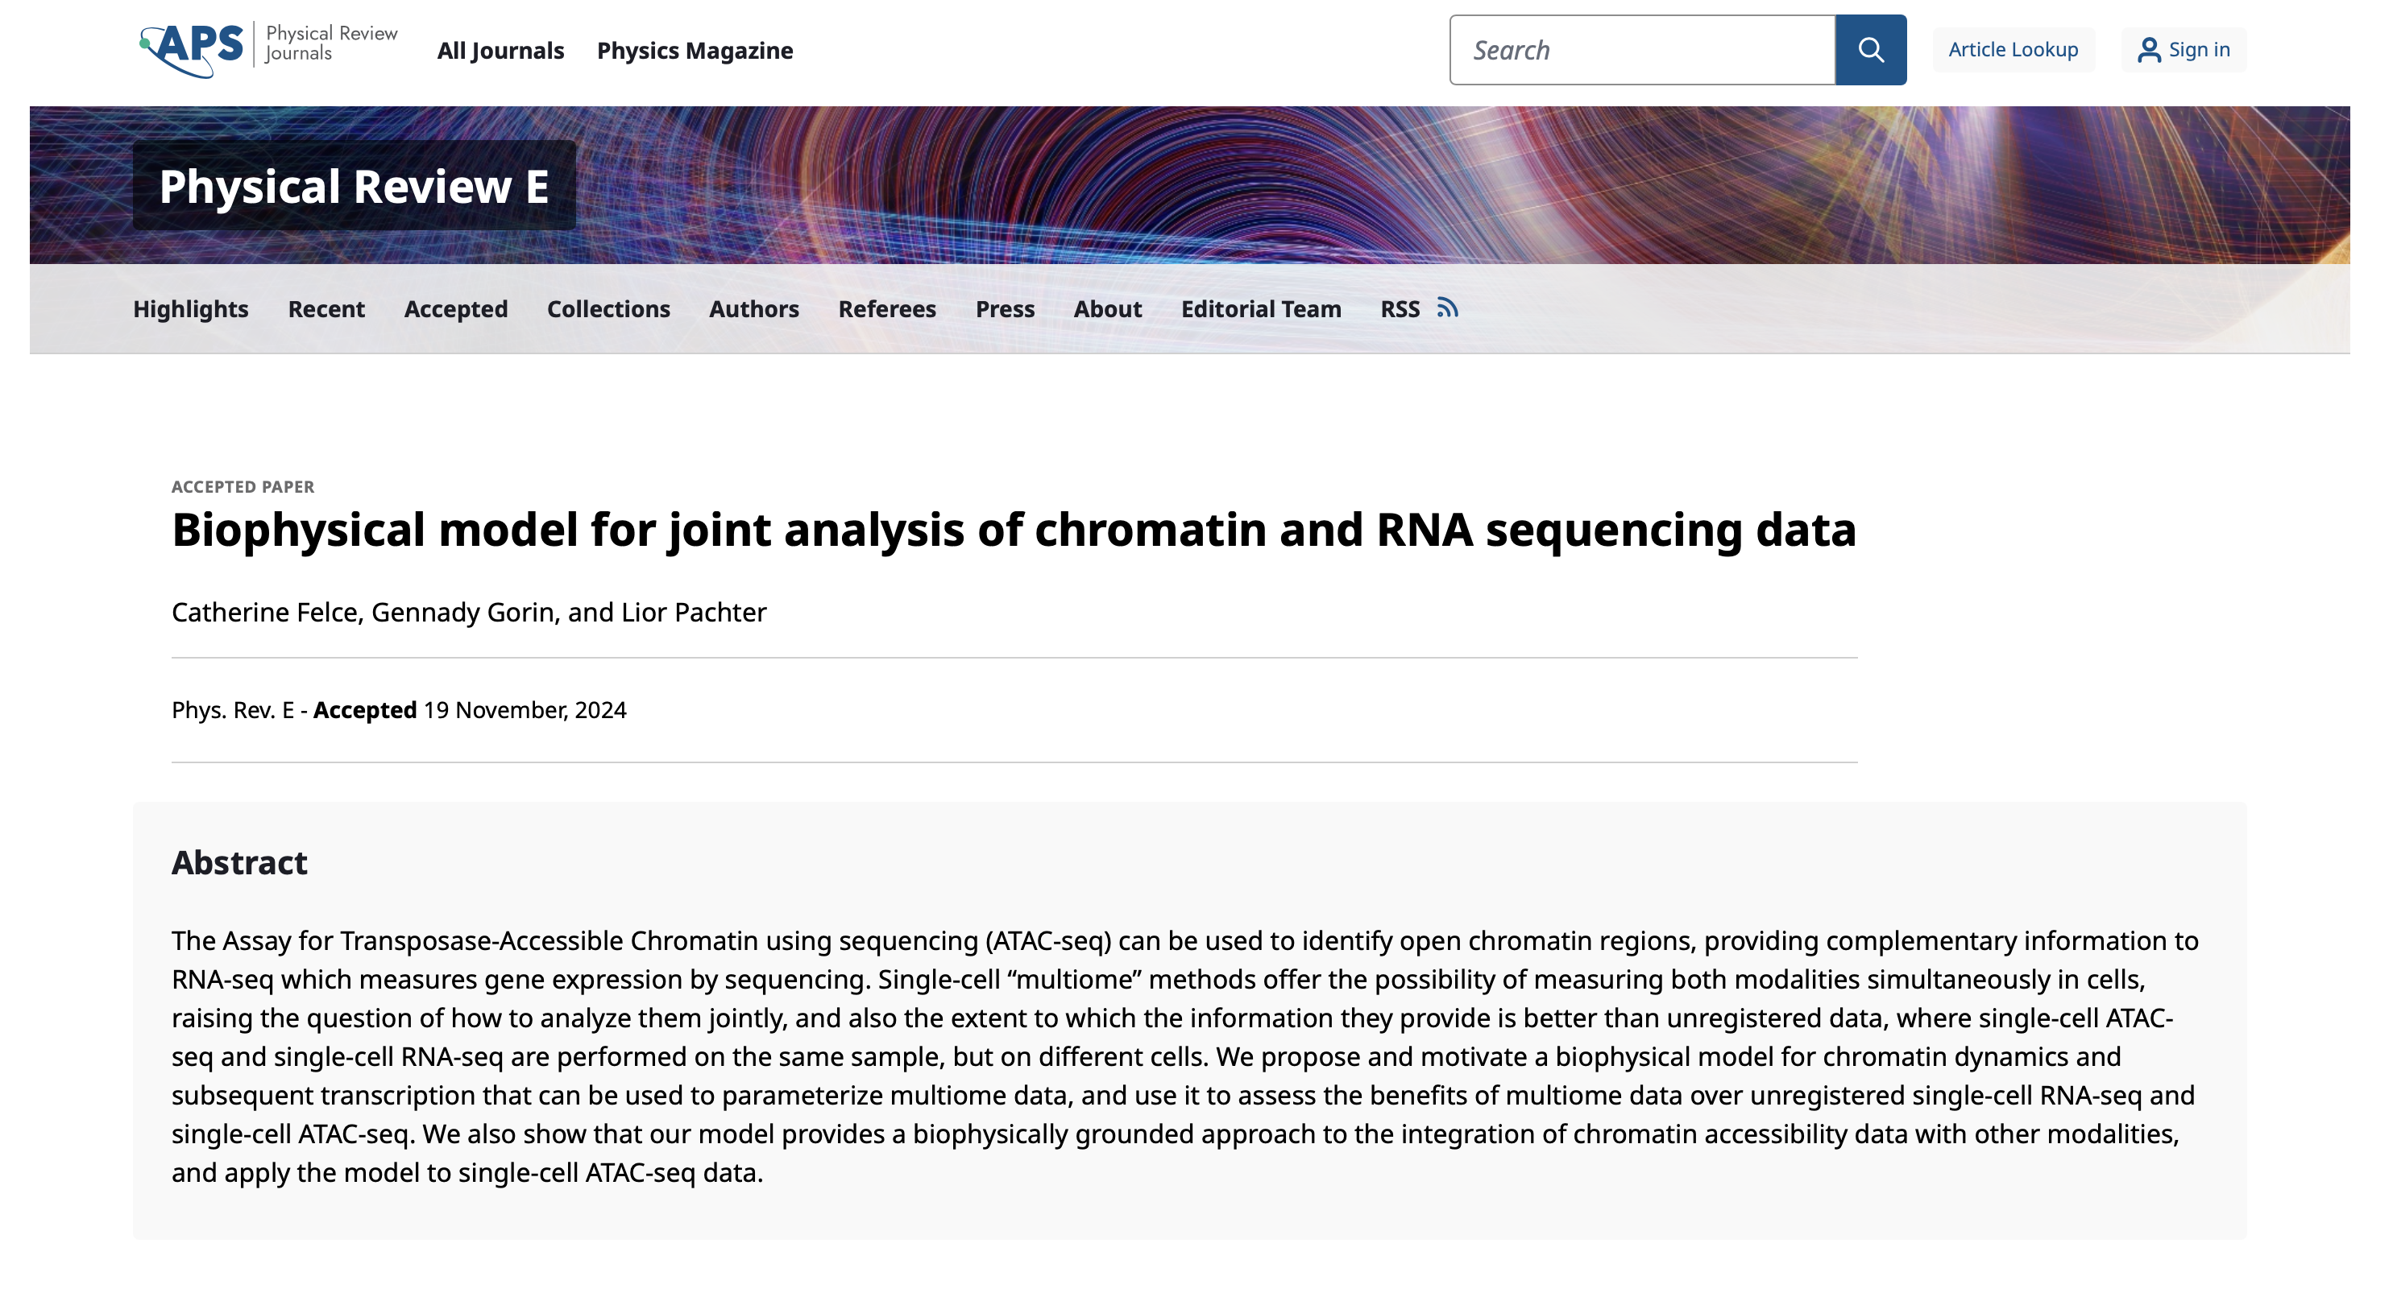
Using meK-means on other groups of modalities
meK-means works on unspliced and spliced RNA counts
ideally would be able to use meK-means on paired ATAC + RNA, paired RNA + proteomics, would just need to edit use of CME…?
Notes:
In reviewer comments they say that CME has been used for ATAC/RNA, unclear how to apply that methodologically here though…

Slide 11
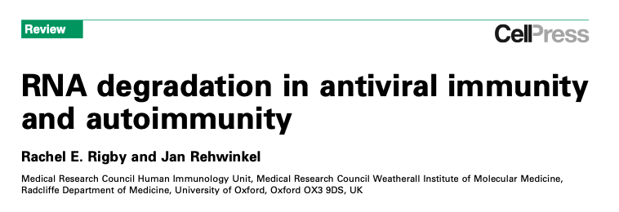

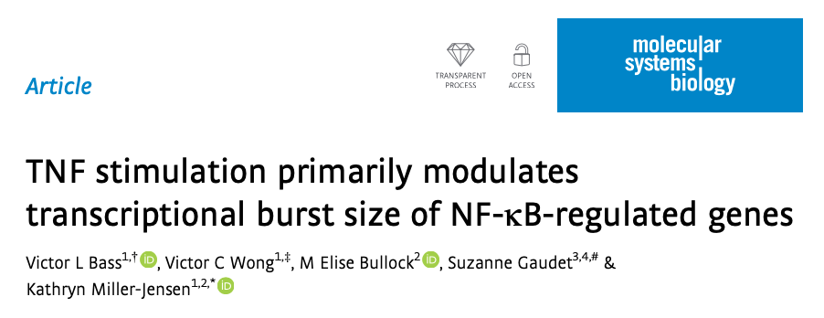
Suggested use cases
10x 5’
When interested in clusters defined by unique transcriptional bursting, splicing, and/or mRNA degradation dynamics… rather than just (mature) mRNA expression, when interested in why gene expression is changed (what step of transcription)
Potentially in stress responses (transcriptional bursting changes), inflammation (RNA degradation changes)
Notes:
maybe also cancer (splicing dysregulated), acute time course experiments (drug treatments)

Slide 12
Using meK-means on (un)spliced RNA counts from P384-4
run velocyto to get U,S (as layers in a loom file)
integrate loom files across patients
run meK-means (CME implemented from Monod package) on (integrated) loom file with U,S counts
- not sure where to input K (expected # clusters) in code, nor how to edit use of CME to other modalities
- lose many genes with their suggested filtering for high U,S counts and overdispersion (bursty transcription), more so than they report
“Datasets were filtered for highly variable genes (HVGs) with SCANPY³⁹, and then filtered for overdispersed genes with sufficient U, S counts. This left 466, 357, 682, 359 genes for the cl3, cl5, MOp_sc, MOp_sn datasets, respectively”
Notes:
I assumed this as 5’ 10X but forgot to check…
Users must also provide a K-value (or a small range of K-values) to meK-means to be tested , not sure where this was though in code
Velocyto scans the aligned reads and classifies them as either:
Spliced Reads: Reads that map to exon-exon junctions (indicating mature mRNA).
Unspliced Reads: Reads that map to introns (indicating pre-mature mRNA).

